Slide 1
Forecasting the 2015 All NBA Teams

Slide 2
Background
Notes:
At the end of every NBA season teams, players and coaches are recognized for their performance through the NBA season.
Awards:
NBA Championship award, MVP, Defensive player of the year, rookie of the year and so forth.
One honor that is given out every season are the All –NBA Teams
There are three teams (1st, 2nd, and 3rd). Each of which is comprised by the best players in their respective positions. So the best guards, forwards, and centers in the league for that given season should be voted on the list? by sportswriters and broadcasters from around the country.

Slide 3
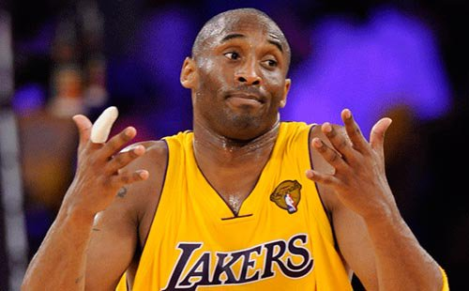


Notes:
Made team 15 times

Slide 4
Motivation
These honors are supposed to reflect the performance of the best players in their respective positions but is this always true?
Do the best players(statistically) have a higher probability of making the team?
Can I use novel data mining techniques to predict which players will be voted onto the 2015 NBA All-NBA Teams?
Notes:
These honors are supposed to be reflective of the best players in their respective positions but is this always true? Are voters voting on players on performance or is it a popularity contest?

Slide 5
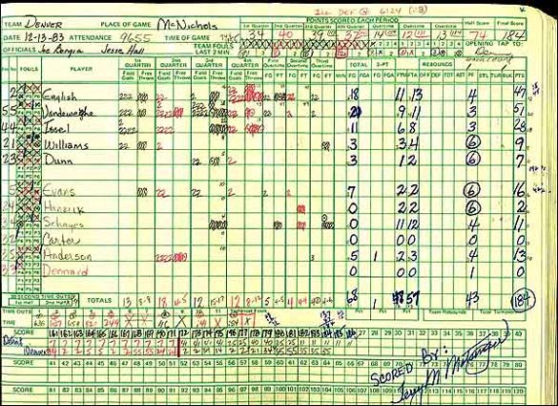
The Data
Every Single NBA player from 1952 – Present
18904 rows(each a player in a given a season)
52 variables
Basic Statistics:
25 Continuous Variables
I.E.: Field goals, Steals, Blocks, Assists, Turnovers
Advance Statistics:
18 Continuous Variables
I.E: Player Efficiency Rating, Win Shares , Box Plus/Minus
All-NBA Teams( 1st, 2nd, and 3rd)
Notes:
1)Basic stats
2)Advance stats: try to capture a players’ performance in relationship to team in a given game.
Metrics that measure how efficient the player produces while on court, the percentage of the teams rebounds he grabbed while on the floor.
Player Efficiency is a measure of per-minute production. Kind of an all in one measure that tries measure a player’s per-minute performance. Positive impacts of 3 points, assists, rebounds, blocks. Negaitive aspects such as turnovers, missed shots and fouls.
TS% : Measure of shooting effciency(captures 2p,3p,ft)
3Pr: Percentage of shots that are three pointers
FT: Number of FT attempts per fg
ORB% : Estimate of percentage of available offensive rebounds a player grabbed while he was on the floor
AST%: Estimate of percentage of teammate field goals a player assisted while he was on the floor
STL% : Percentage of steals
BLK%: Percentage of blocks
TOV: Estimate of turnovers a player committed per 100 possessions
USG%: How many team plays were ran while player was on the floor.
Win Shares : estimate of the number of wins the player has contributed to.
BPM:
Box Plus/Minus (BPM):a box score estimate of the points per 100 possessions a player contributed to above the league average.
is a box score-based metric for evaluating basketball players' quality and contribution to the team. It is the latest version of a stat previously called Advanced Statistical Plus/Minus; it is NOT a version of Adjusted Plus/Minus, which is a play-by-play regression metric. BPM relies on a player's box score information and the team's overall performance to estimate a player's performance relative to league average. BPM is a per-100-possession stat, the same scale as Adjusted Plus/Minus: 0.0 is league average, +5 means the player is 5 points better than an average player over 100 possessions (which is about All-NBA level), -2 is replacement level, and -5 is really bad.

Slide 6
Pre-Processing
Collect data
Web Scrape via Beautiful Soup
Join Data
Joined three datasets together by player name and season
Basic, Advanced, Historic Team data
Cleaned data
Filled missing values in with 0 or median value
Re-mapped positions
PG,SG : G
SF, PF : F
Notes:
Originally Found Data pulled from R script on Reddit---PERFECT?
Only contained Basic Statitstics
Used Webscraping to collect more advance statistics and historic all-nba team data
Joined data
Missing Data
Assess missing values by either filling the variable with 0 or median.
Shooting percentage variable that were missing because players did have an attempt
Some variables weren’t taken into account until mid-late 70s, 80s(Three points, stls, tov, orb, drb, blocks), they were given 0
TRB and assists have been calculated over time, but their advance metrics were missing, so I took the median. Aslo did for BPM and Winshare
4) Converted PG,SG to Guards and Small forwards , Power forwards to Fs
Used
No Api
Missing Data
Variable issue
Average(or median) or fill in with 0
Grouped by position

Slide 7
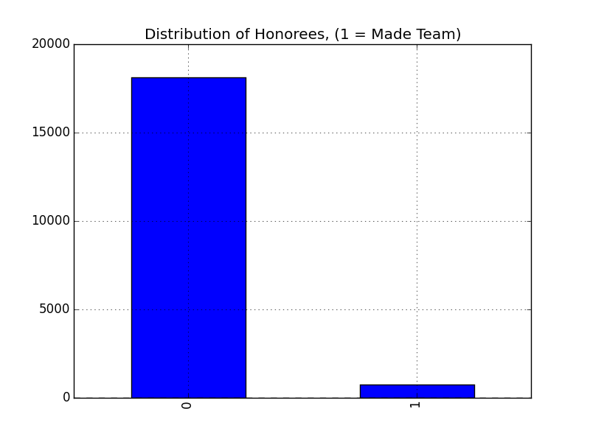

Slide 8
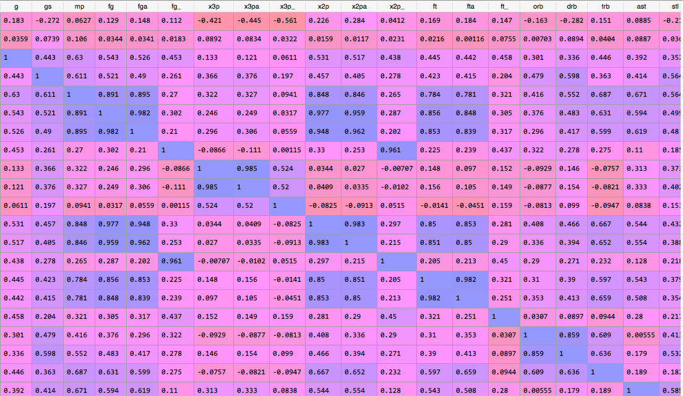
Exploration/Feature Selection
With large set of variables:
Scatterplot Matrix ≠ easy to interpret
Correlation Matrix = easy to interpret
Didn’t use features that were inherently correlated like:
FGs Made, Missed and Percentage
Offensive and Defensive Rebounds
Wins Shared(WS), DWS, OWS
Notes:
Some features were inherently correlated:
Field goal Attempt/Made
Offensive/Defensive Rebounds
Win Shared/Defensive/ Offensive
Not ≠

Slide 9
Analysis Plan
Use logistic Regression to predict the probability that a player makes a team
Input Variables:
First Model: Basic Stats
Second Model: Advanced stats
Third Model: Combination
Y variables:
Converted Historic Team Variable to binary variable
1 = made a team
Using the best variables from logistic regression in:
Decision Trees and Random Forests
Notes:
Classification problem- Use input variables to predict probabilities of class membership
Logistic can only predict whether some one makes a team
The other two will predict what team a player will be on(1st, 2nd, 3rd)

Slide 10
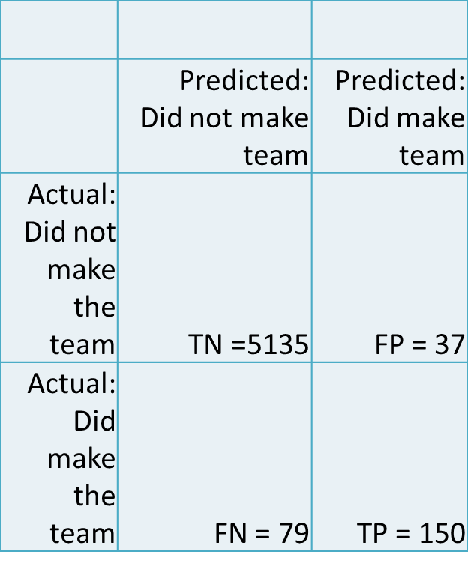
Results
Third Model: Combination of Basic and Advanced Stats
Specificity: .992
Sensitivity: .655
Overall Accuracy: .978
Notes:
False positive rate:
When actual value was no, how often did they make team (how often was it wrong): .006
Specificity: For those who didn't make the team, how many did it predict correctly? .992
Sensivity Rate : My TP rate for individuals who actually made the team vs my prediction, was correctly predicted .655.
First Run:
Specificity: .991
Sensitivity:. 572
Overall Accuracy: . 973
Second Run
Specificity:.994
Sensitivity: .54
Overall Accuracy: . 975

Slide 11
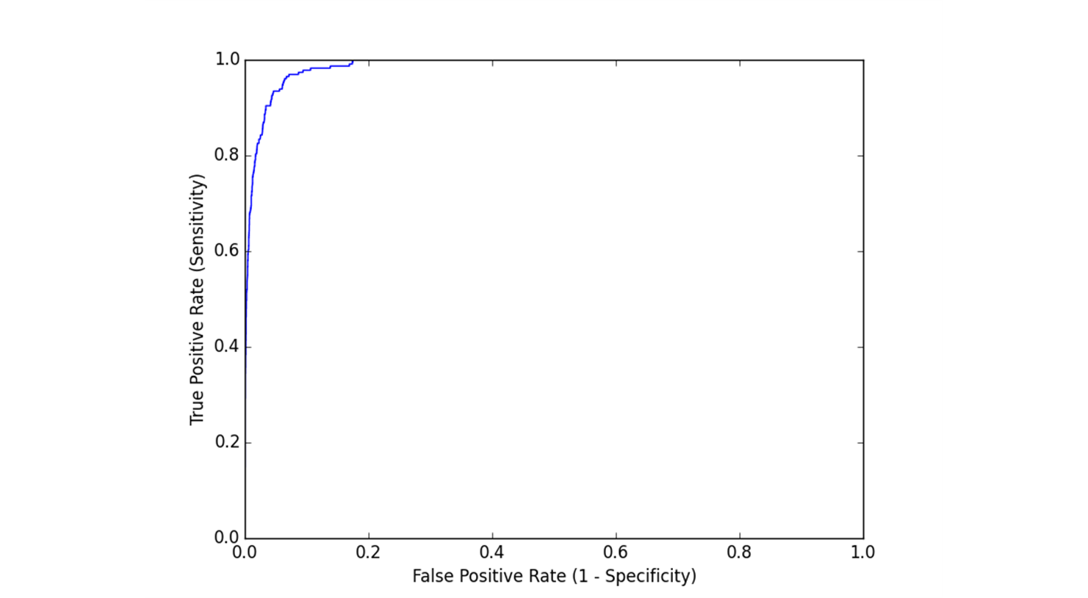
ROC Curve
Notes:
Used cross-validation to get my average ROC_AUC value which was .986.; which is good because I sensitivity is important to me here. I was the TP rate to be as close to one as possible.
ROC want TP to be close to 1.
My cross validation score was
Accuracy = .965
AUC = .986
I found that the model accurately predicted 8/15 players correctly with a threshold of .5

Slide 12
Can I use decision trees or random forests to predict what team they make?
Notes:
Can decision tree capture what specific teams players made?
Supervised classification model to predict what class each player makes?

Slide 13
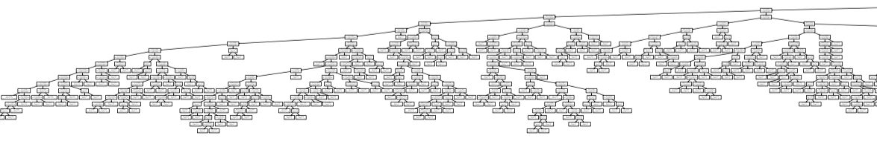
First Part…...

Slide 14
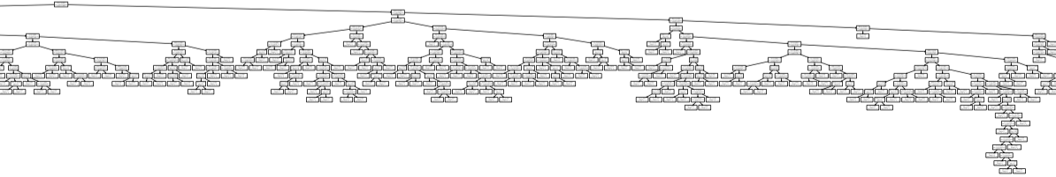
Second Part…...

Slide 15
Win shares
Player Efficiency Rating
Minutes Per game
Notes:
Found that the first major splits occur at with these variables:
Win Shares
Player efficiency Rating
Minutes Per game
Win shares is the estimated number of wins an individual player contributed. The performance of a player is typically going to effect how many games the team wins. The best player on their team are going to be doing all the tangible things they need to help their team win and doing them efficiently. So yes scoring a lot of points is good but if your shooting 8 for 30 that’s not effective, and your potential missing opportunities to help team main or get lead. The more minutes the player is left on the court to produce through the game, creates more efficient production and could potentially increase number of wins.
(scoring a lot of points effectively, not taking a ton of bad shots)
Player efficiency rating: a metric of a player’s per-minute performance. So not just scoring a lot of points: scoring 16 points on ( 8/30); committing steals that lead to pts.
MP: minutes per game. The best players in the league are typically going to get most minutes in a game.
PER strives to measure a player's per-minute performance, while adjusting for pace. A league-average PER is always 15.00, which permits comparisons of player performance across seasons.
PER takes into account accomplishments, such as field goals, free throws, 3-pointers, assists, rebounds, blocks and steals, and negative results, such as missed shots, turnovers and personal fouls. The formula adds positive stats and subtracts negative ones through a statistical point value system. The rating for each player is then adjusted to a per-minute basis so that, for example, substitutes can be compared with starters in playing time debates. It is also adjusted for the team's pace. In the end, one number sums up the players' statistical accomplishments for that season.
Win shres

Slide 16
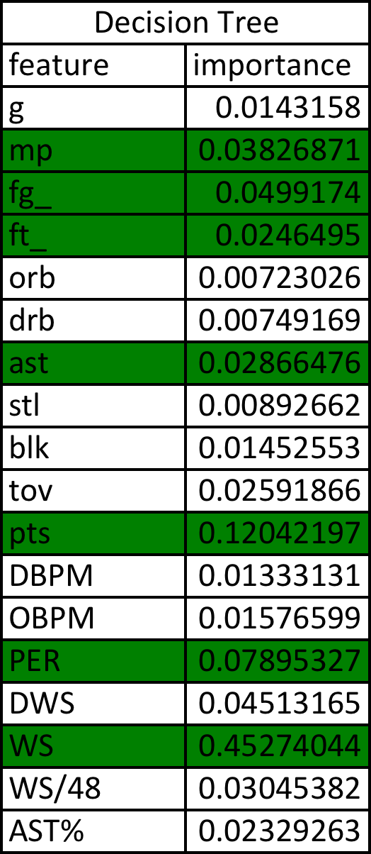
Important Features
Notes:
Minutes played, FG percentage, FT percentage, Ast, Pts, PER, WS

Slide 17
2014 Predictions
Green = All three models correct predicted if player made team and what team they made
Yellow = Predicted who would make it team but didn’t not correctly predict what team
Red = Made team but did not correctly predict
Notes:
Green = All three models correct predicted if player made team and what team they made
Yellow = Predicted who would make it team but didn’t not correctly predict what team
Red = Made team but did not correctly predict
Logistic Regression:
With a probability threshold of .5, predicting 8/ 15 players that made the team in 2014.
The Decision Trees and Random Forests gave basically the same results. So not sure how to evaluate how one may be better than the other.
So did the best players in their respective positions get voted to the all nba teams?
My model suggests that that’s its not always the case….
Forward position:
Carmelo Anthony should have made a team over: Paul George, LaMarcus Aldridge
Anthony Davis
Center: Demarcus Cousin should have made a team over Al Jefferson and Dwight Howard
Guards:
John Wall over tony parker, damian lillard, goran dragic
Kyle lowry over tony parker, damian lillard, goran dragic

Slide 18
2015 predictions!!!
Notes:
Given the results from my 2014 projections I was excited to see who might win this year

Slide 19
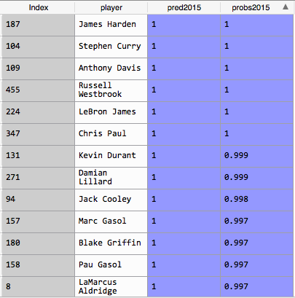
Who is this guy????
Notes:
Logistic Regression: Found similar players but all with really high probablities of making the team
How many? 111
Then there was this guy…Jack Cooley

Slide 20

Who is Jack Cooley?
Probability of making an All NBA Team is: .998
stats:
2 minutes played(total)
Only has 4 pts
100% FGp
PER = 81.1(the highest in the league right now)
Notes:
However, this anomaly is also found in the 2014 data DeAndre liggins whose PER was 129.1….But his probability of making the team was only…. .143

Slide 21
Next Steps
Investigate problems with predictions
Lead to extremely high probabilities of making the team.
Might be due to using partial season data
Need to predict using less number of variables
Having so many variables may be impacting the most important variables in the model distorting the results.
Would like to see if making the team in the past increases the likelihood of making the team? Is it a popularity contest?
Notes:
Relative importance of features
2015 predictions
I applied the first logistic regression to the current 2015 data but seem to be getting odd results. Lead to extremely high probabilities of making the team.
-Might be due to using partial season data
-Need to predict using less number of variables
Having so many variables may be impacting the most important variables in the model distorting the results.
Would like to see if making the team in the past increases the likelihood of making the team? Is it a popularity contest?

Slide 22
Questions or better yet…Suggestions?

